Slide 1

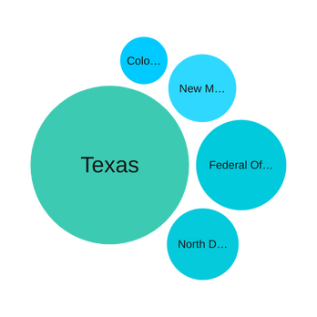
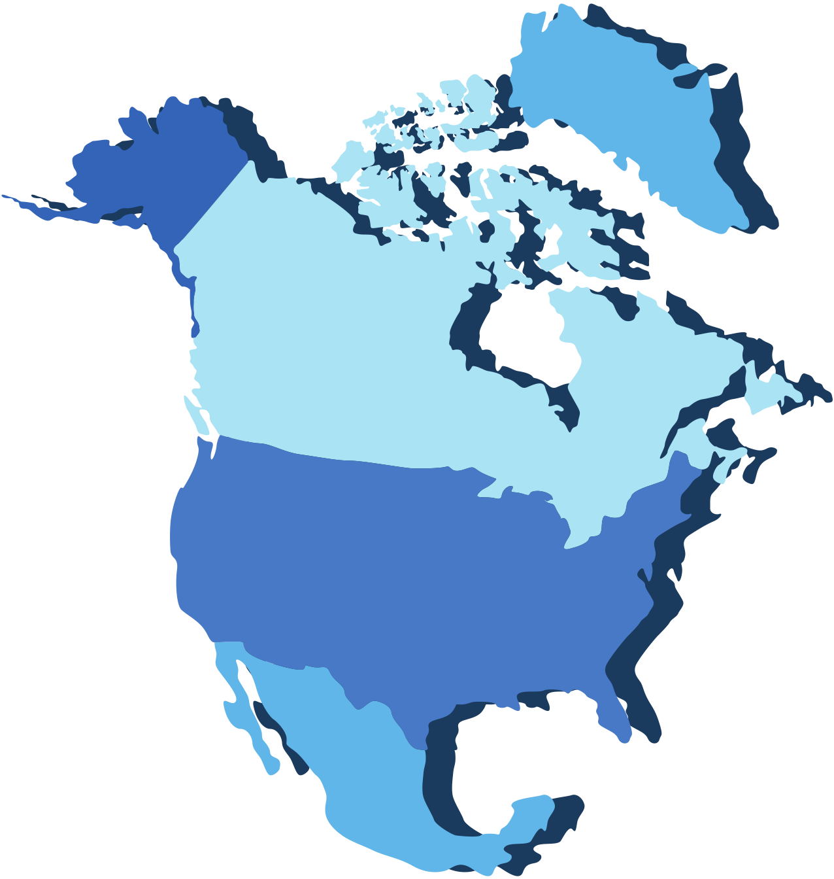
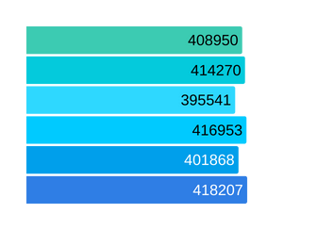
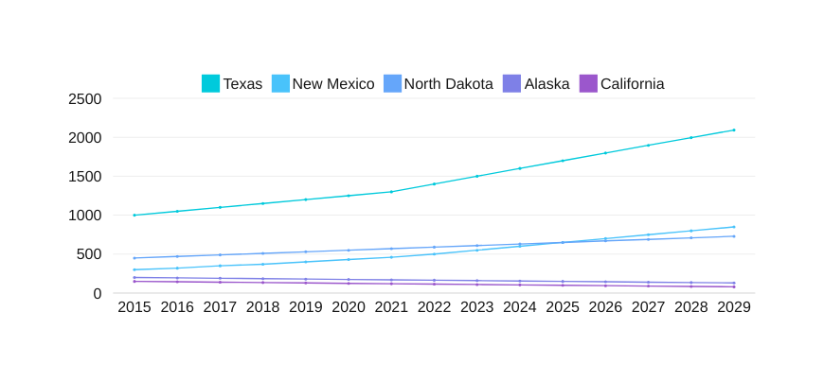
NORTH AMERICA OIL AND GAS PRODUCTION
Select
State/Province
Select
Country
42%
Comparison of Regional Production Efficiency
Production Trend Over Time
Best Oil Producing Regions
increase in production from New Mexico
13%
decline in production experienced by California
Future Production Forecast
8%
increase. in production seen in Texas

